Slide 1
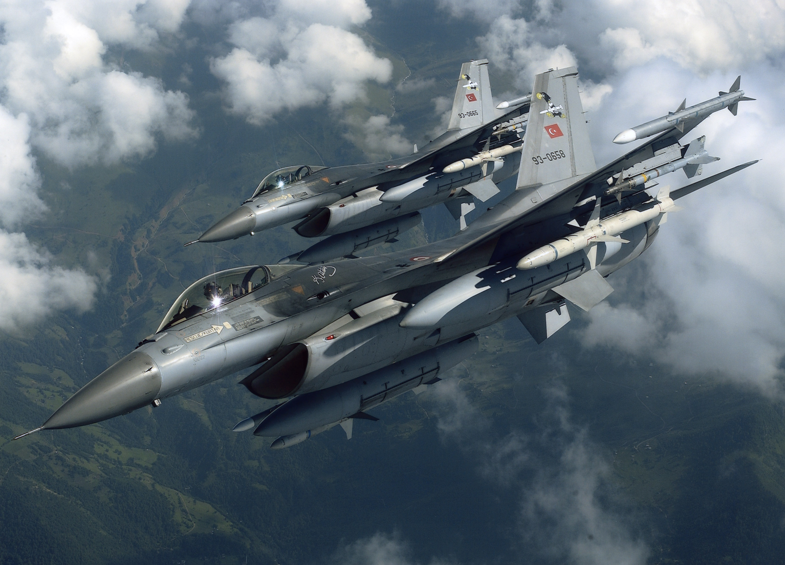
VIRTUAL REALITY FLIGHT SIMULATOR
PROJECT MENTOR: DR. AJAY KUMAR
Associate Professor
Thapar Institute of Engineering and Technology, Patiala
Project Team:
102003121 Abdul Basit Bhat
102183003 Anmol Preet Kaur
102003113 Ritika
102183024 Sasmita Maharana

Slide 2
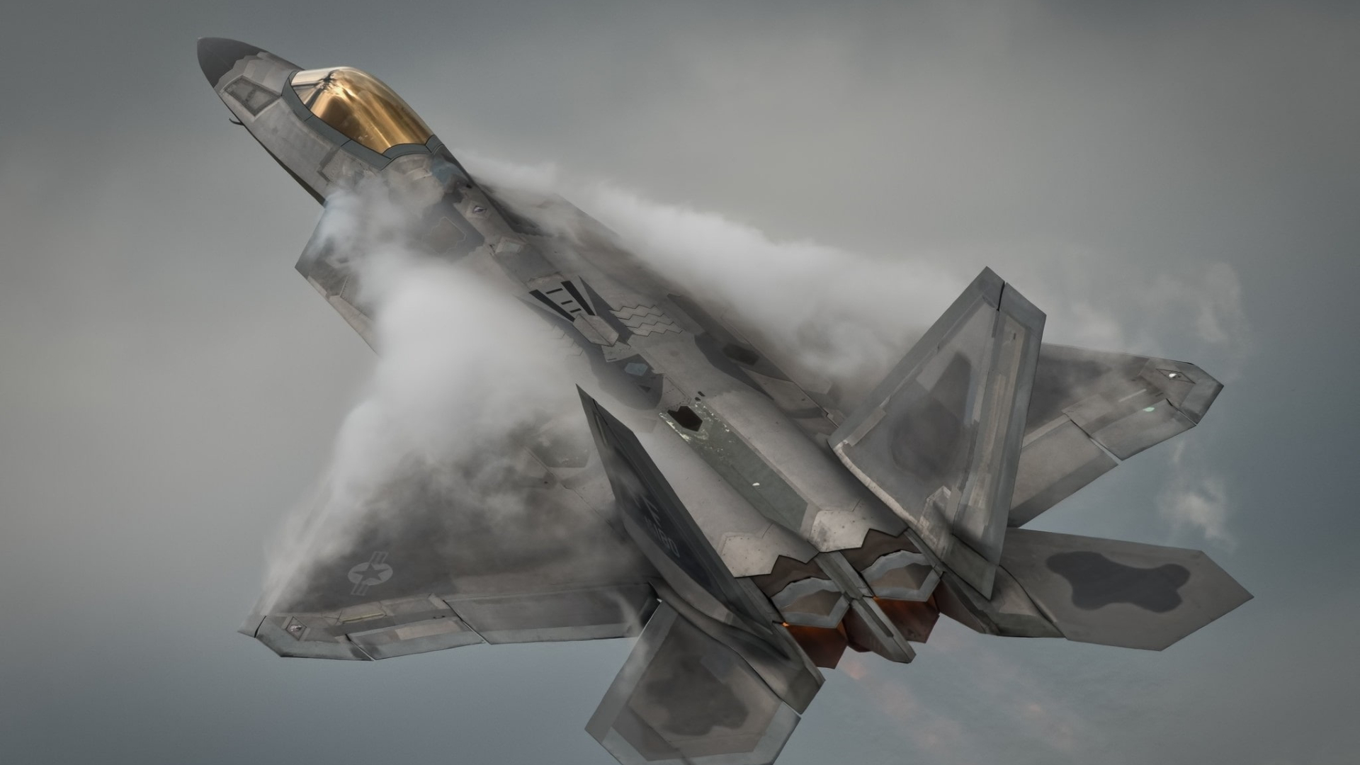
Problem Definition
The Problem at hand is the requirement for immersive flight training and entertainment solution that fills the void between pricey full-motion flight simulators and conventional desktop flight simulators. While full-motion simulators are unaffordable for many training centres, traditional flight instruction techniques can be expensive and geographically constrained. A Virtual Reality flight simulator is a flexible solution to these problems that combines innovative technology, realistic training, accessibility, and fun.
Project Scope
Create a visually appealing and engaging virtual environment that simulates a wide variety of environments. Give people a 360-degree panoramic vision using VR technology to foster a sense of presence and engagement.
User Interaction: Include logical and simple controls that let users engage with the plane, the cockpit, and the mission goals. support a range of input devices, such as gaming pads and VR motion controllers.
Features geared towards education: Offer individuals interested in learning about aviation education tutorials and learning tools. These materials could address emergency procedures, instrument flying, navigational skills, and flight concepts.
Objectives
To develop a Virtual Flight Simulator for educational purposes in Aviation Institutions.
To Verify and Validate the system and its effectiveness in satisfying the need of Virtual Reality in Aviation Institutions

Slide 3
Literature Survey
1. Dorn and Johnson[1] investigated the usability and effectiveness of a VR flight simulator for training commercial airline pilots. The authors found that the simulator was generally well- received by the pilots, and that it provided a realistic simulation of flight conditions.
2. Van den Berg and Houten[2] evaluated the effectiveness of a VR flight simulator in training military pilots. The authors found that the simulator was effective in training pilots on basic flight skills.
3. R. S. Kennedy, J. Drexler, J. Kennedy, and R. M. Bennett [3] investigated the incidence and causes of simulator sickness in VR flight simulators. The authors found that simulator sickness was a common problem, and that it was primarily caused by conflicts between visual and vestibular sensory input.
4. B. E. DeRoche, D. P. Williams, D. D. Rupp, and C. J. Vincenzi [4] evaluated the effectiveness of a VR flight simulator for training military pilots. The authors found that the simulator improved flight safety and reduced the number of accidents.
5. C. H. Kim, D. H. Kim, S. W. Yoo, J. S. Kim, and S. W. Kim [5] reviewed 31 studies on the effectiveness of VR flight simulators for pilot training. The authors found that VR simulators were generally effective for training, and that they had several advantages over traditional training methods, including cost savings and increased safety.

Slide 4
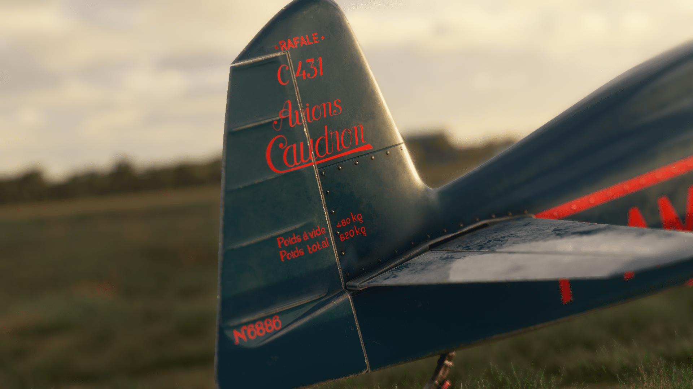
Project Analysis
The virtual flight simulator aims to provide an immersive and realistic flying experience through virtual reality technology. It caters to aviation enthusiasts, aspiring pilots, and professional pilots seeking to enhance their skills and knowledge in a safe and controlled environment.

Slide 5
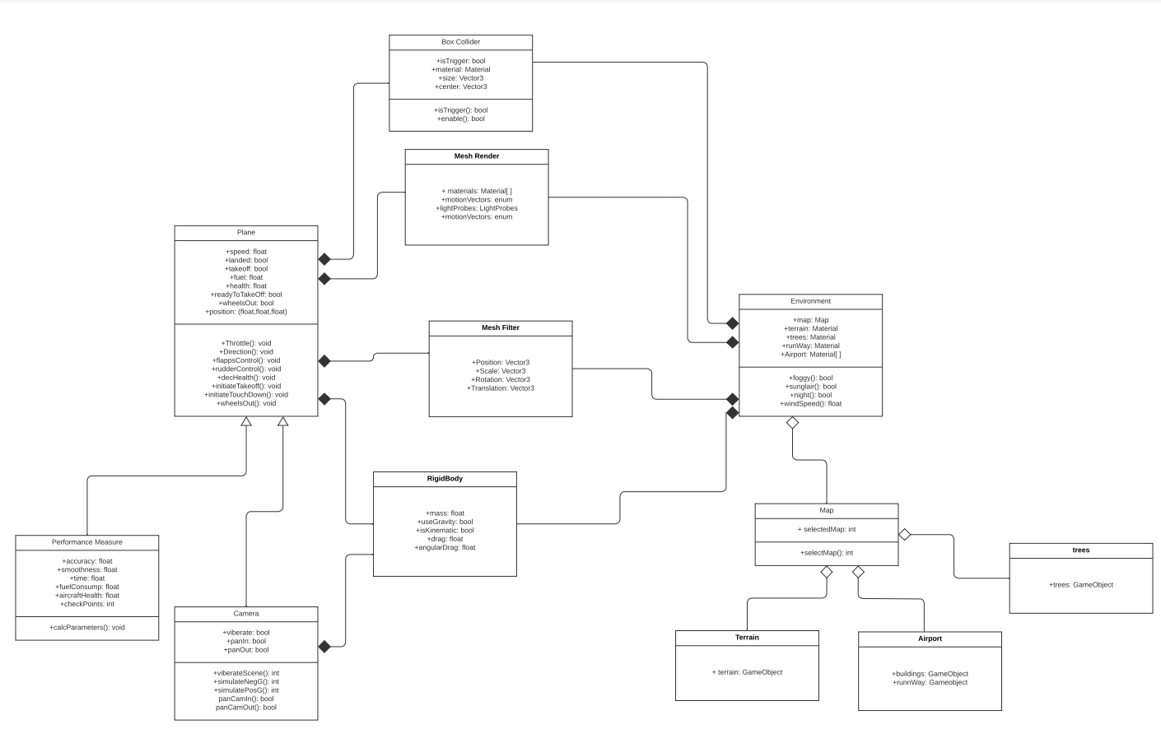
UML Diagram

Slide 6
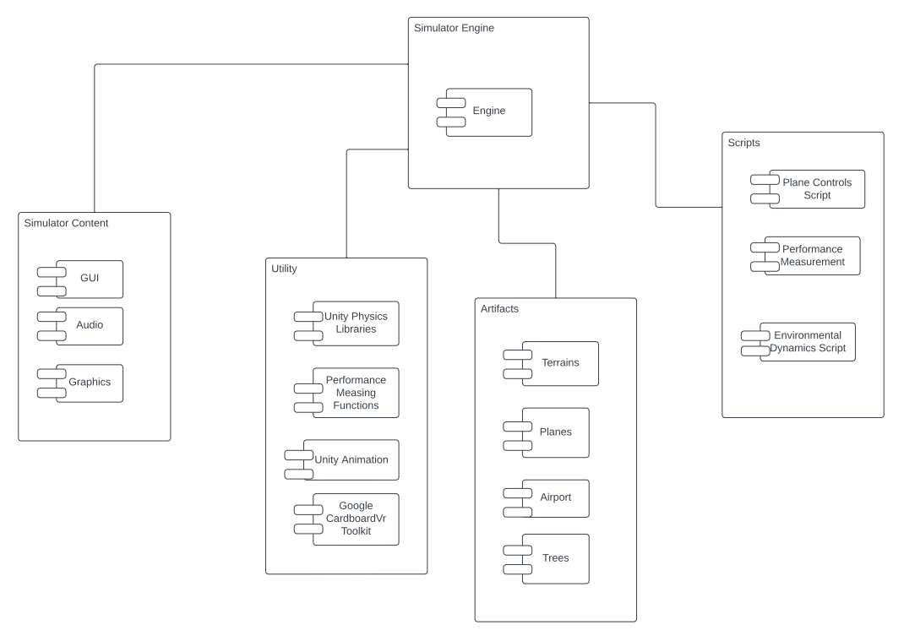
Component Diagram

Slide 7
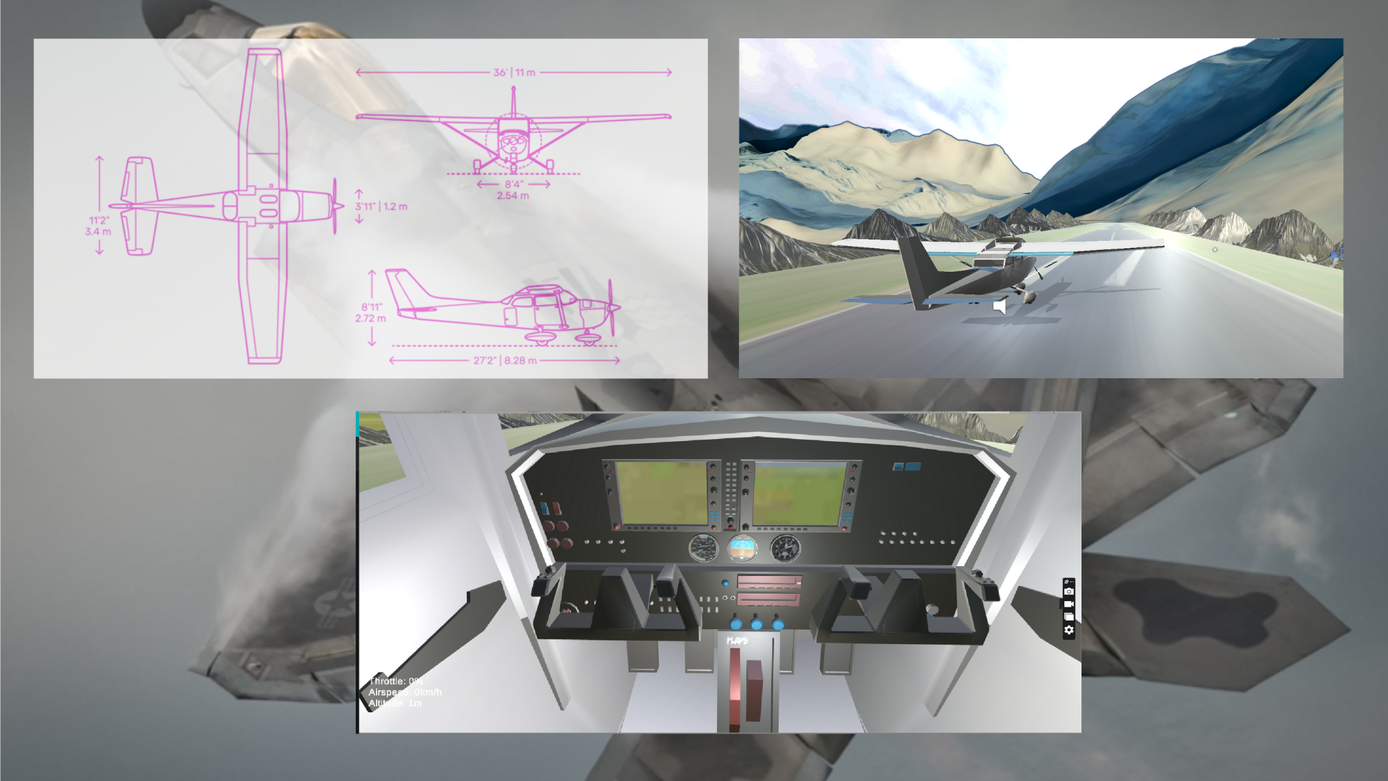
Plane Modelling

Slide 8
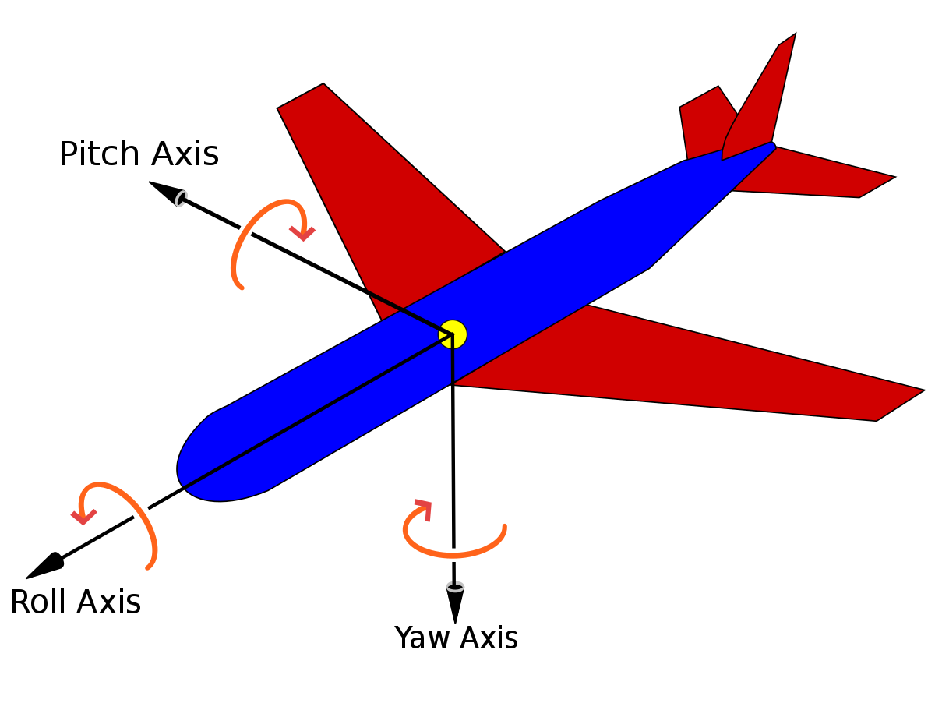
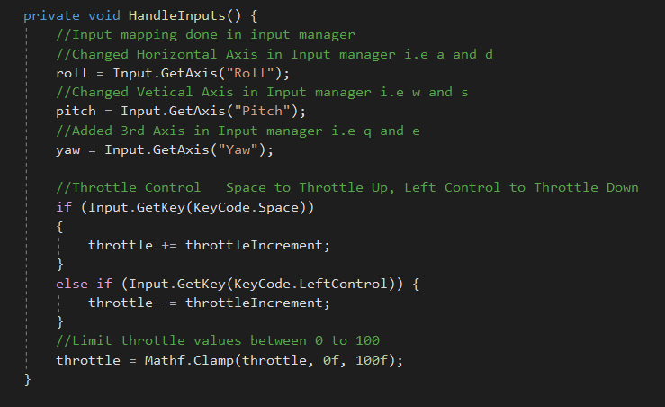
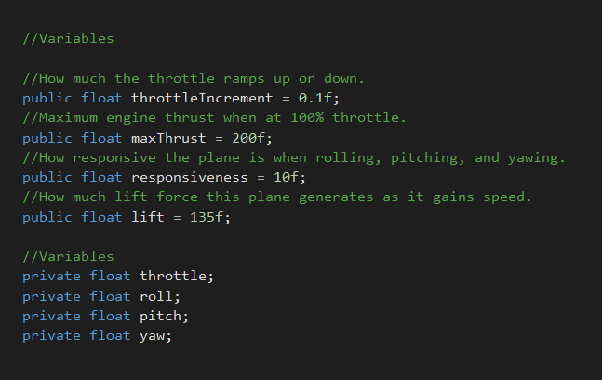
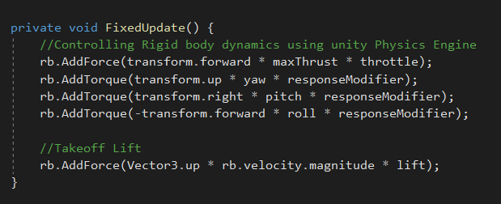
Mathematical Modelling

Slide 9
Plane Object
Parent
Child
Camera Object
Camera Controller Script
Plane Controller Script

Slide 10
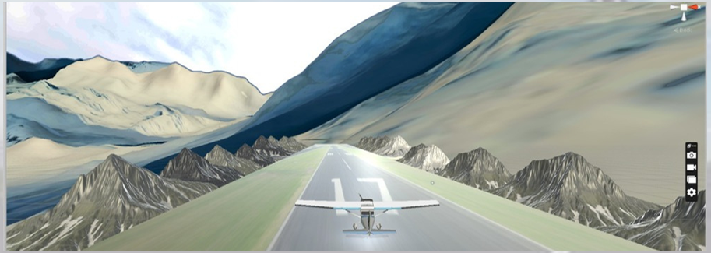
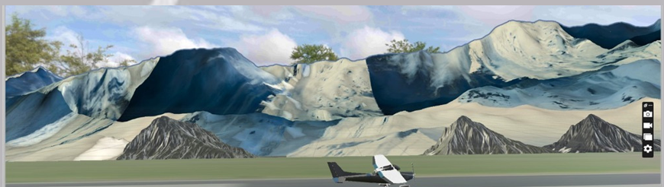
Environment Modelling

Slide 11
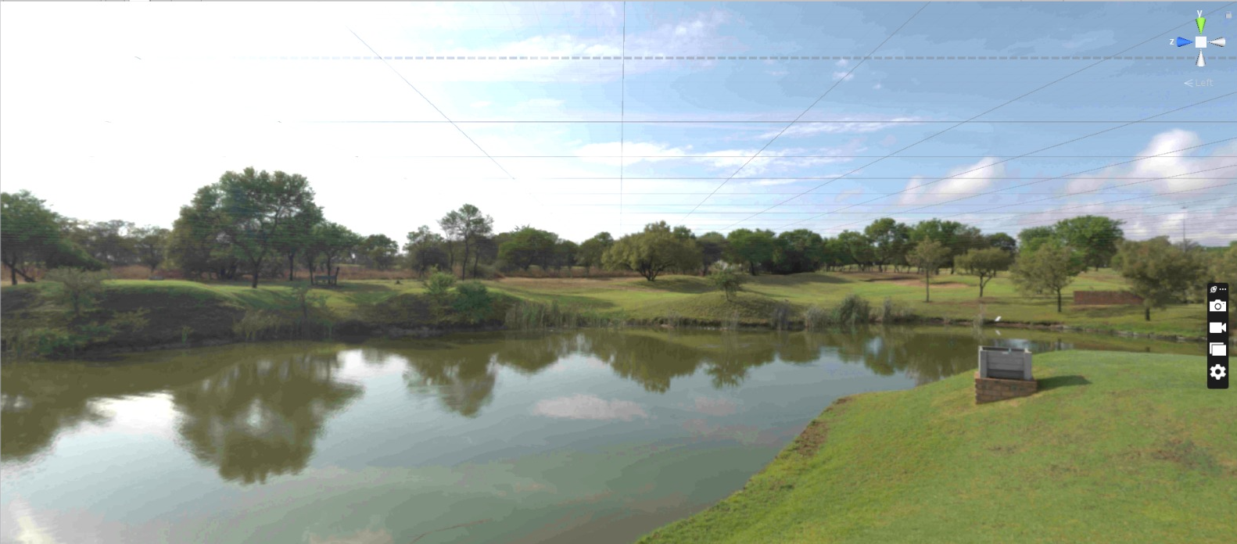
Environment Modelling

Slide 12
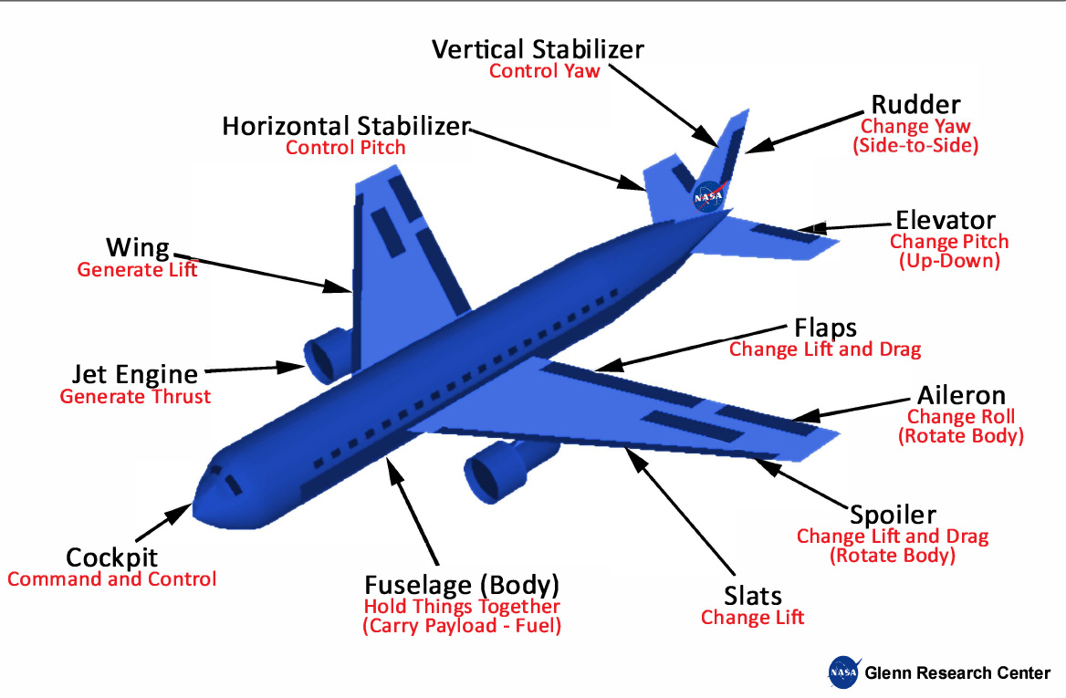
Next Step
Simulating Dynamics of Commercial Aircrafts

Slide 13
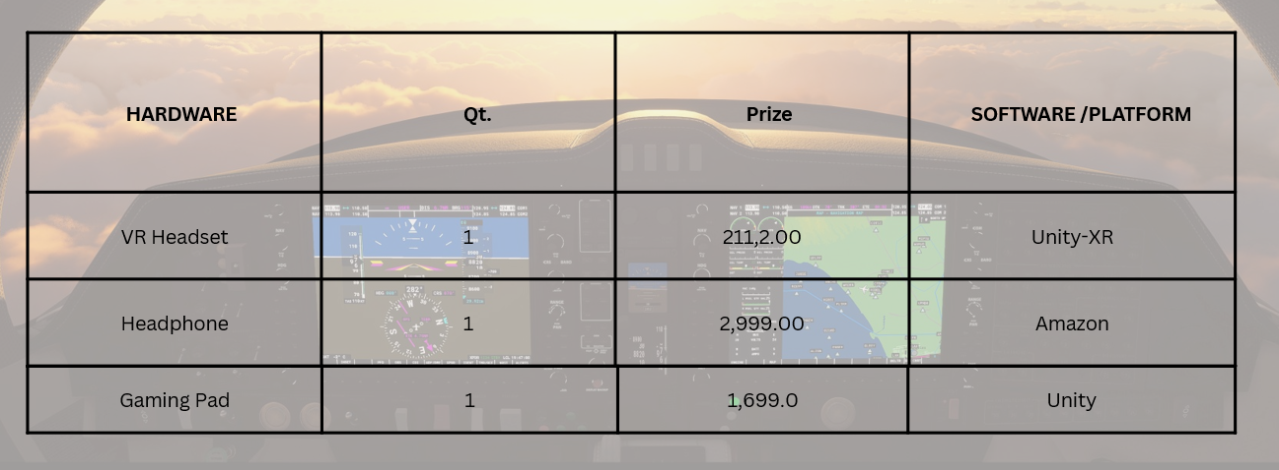
Cost Analysis

Slide 14
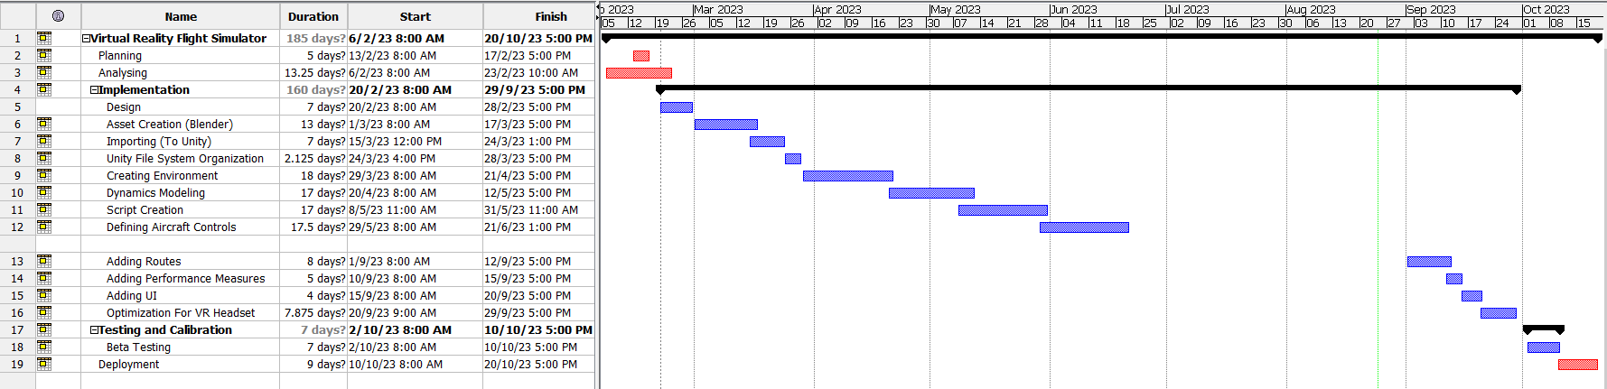
Gantt Chart
Completed
Next Steps

Slide 15
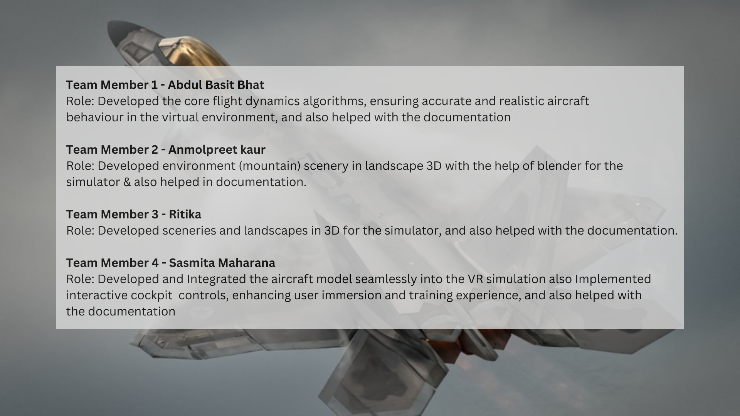

Slide 16
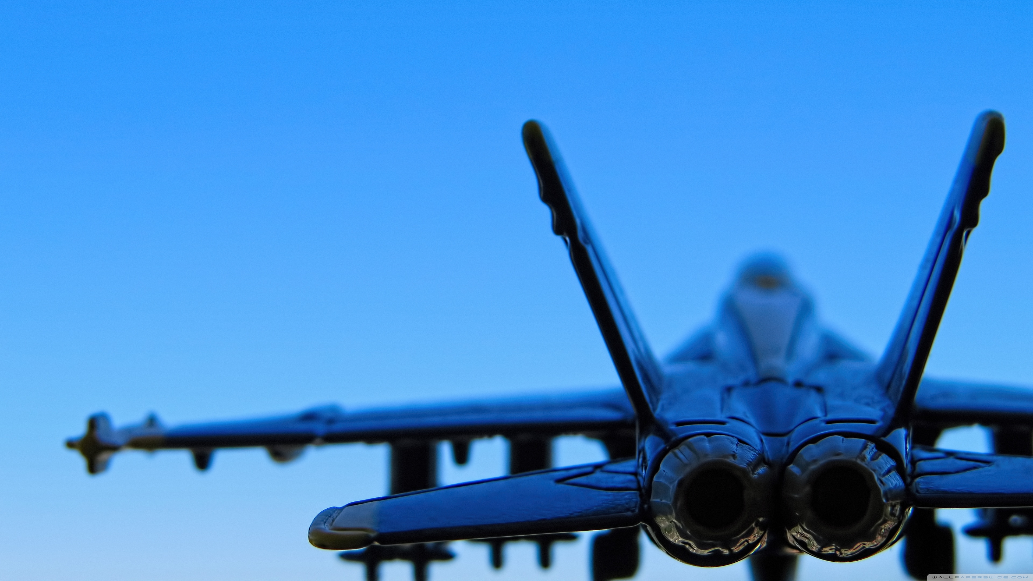
Resources
Unity Learn
https://learn.unity.com/course/beginner-scripting
Airplane Parts and Functions
https://www1.grc.nasa.gov/beginners-guide-to-aeronautics/airplane-parts-function/
Aircraft Dynamics
https://en.wikipedia.org/wiki/Aircraft_flight_dynamics
Google
https://www.google.com/
Pintrest
https://in.pinterest.com/

